Slide 1
Lecture 22: Molecular orbitals
California State University, Fullerton
2023 Fall Semester – Chem 123

Slide 2

QUESTIONS, COMMENTS, AND CONCERNS?

Slide 3
Outline
Announcements
Ch. 11: Molecular Shape and Bonding Theories
Valence Bond Theory – Hybrid Orbitals
Molecular Orbital Theory – Molecular Orbitals
Ch. 12: Liquids and Solids
Intermolecular Forces – Connection to Real World
Phase Changes and Heating Curves
Vapor Pressure, Viscosity, Freezing/Boiling Point, and Surface Tension
Phase Diagrams
Types of Solids

Slide 4
announcements
Final Exam on Dec 11th at 5:00pm – 6:50pm in MH 121
Cumulative – 50% covering new materials and 50% covering old materials
6 – 8 questions
Exam 3 has been graded; Aiming to complete Exam 2 by End of Tues, Nov 28th
As of today, class average is 72%
EC opportunity up to 10 pts towards homework assignment grade
Online Homework Ch 11 due Tues, Nov 28th and Ch 12 due Fri, Dec 1st at 11:59pm

Slide 5
Outline
Announcements
Ch. 11: Molecular Shape and Bonding Theories
Valence Bond Theory – Hybrid Orbitals
Molecular Orbital Theory – Molecular Orbitals
Ch. 12: Liquids and Solids
Intermolecular Forces – Connection to Real World
Phase Changes and Heating Curves
Vapor Pressure, Viscosity, Freezing/Boiling Point, and Surface Tension
Phase Diagrams
Types of Solids

Slide 6
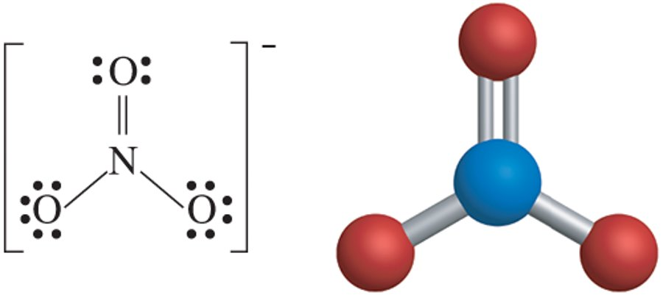
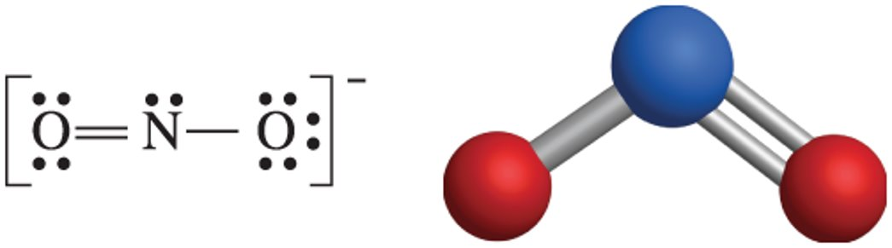
Atoms and molecules
Q: What are molecules made of?
Q: What are atoms made of?
Q: What determines the chemical properties of materials?

Slide 7
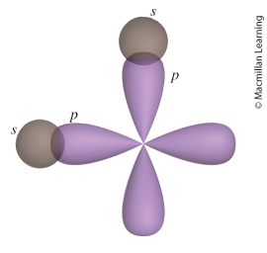
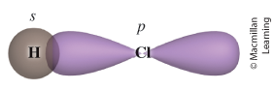
Valence bond (VB) theory
Recall Lewis Structure and VSEPR Model. What are their purposes?
VB Theory Assumptions:
Electrons occupy atomic orbitals of individual atoms within a molecule
Electrons of one atom are attracted to the nucleus of another atom
Concept of Bond – overlap of atomic orbitals

Slide 8
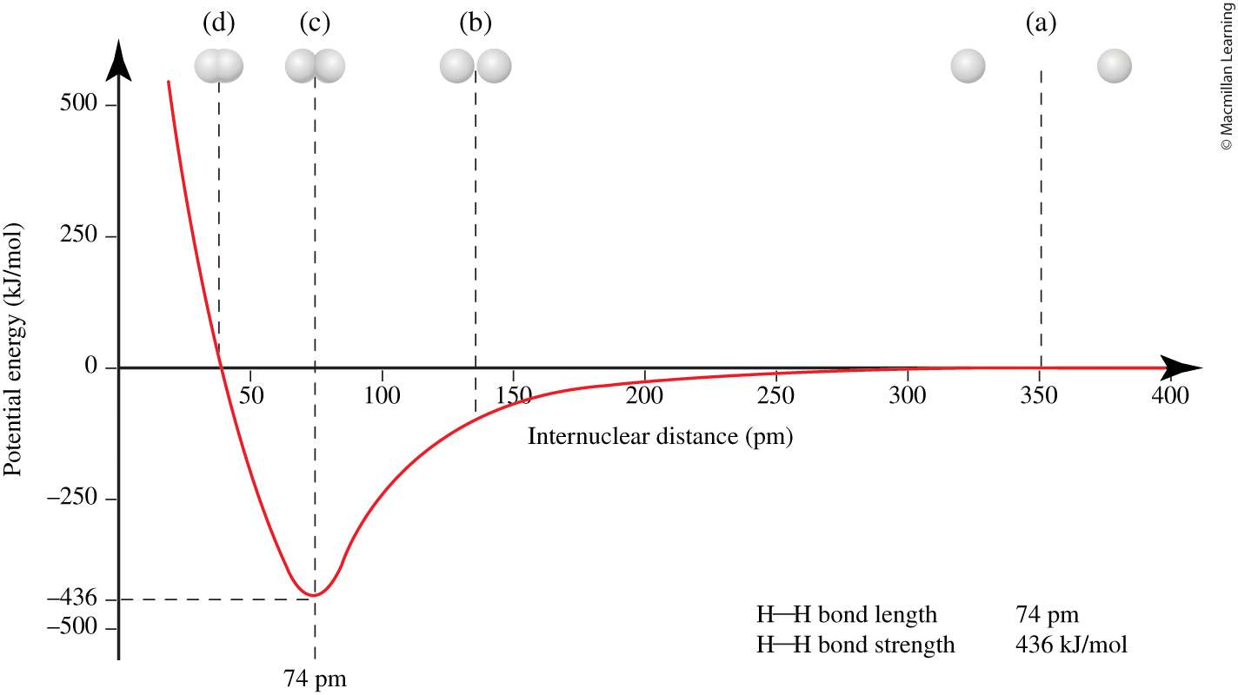
Valence bond (VB) theory

Slide 9
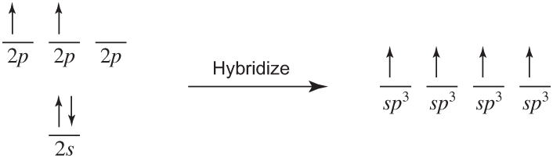
Valence bond (VB) theory: Hybridized orbitals
Number of hybrid orbitals that results is always equal to the number of atomic orbitals
Shapes and energies of atomic orbitals being combined determine the shape and energies of the hybrid orbitals
Many types of hybrid orbitals and are specific to the molecule that yield ground state energy e.g. C atom:

Slide 10
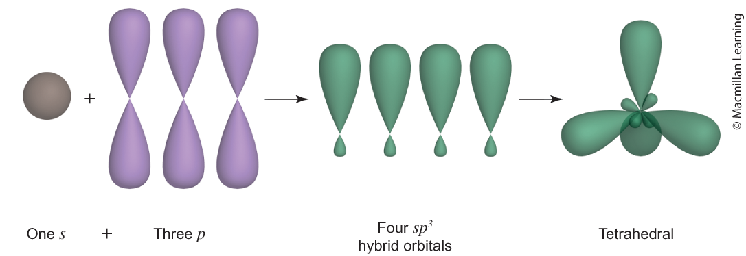
Valence bond (VB) theory: SP³ Hybridized orbitals
Number of hybrid orbitals that results is always equal to the number of atomic orbitals
Shapes and energies of atomic orbitals being combined determine the shape and energies of the hybrid orbitals
Many types of hybrid orbitals and are specific to the molecule that yield ground state energy e.g. C atom:

Slide 11
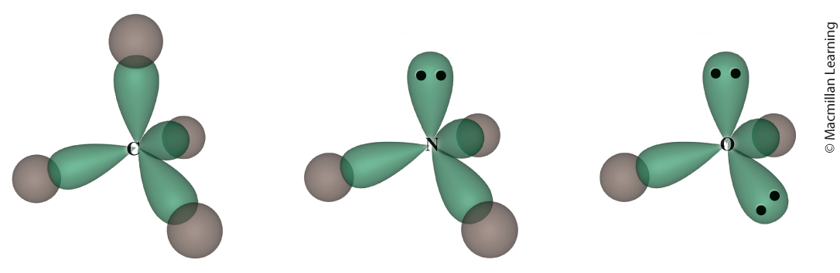
Valence bond (VB) theory: SP³ Hybridized orbitals
Note that hybridized orbitals and the electronic arrangement+molecular shape

Slide 12
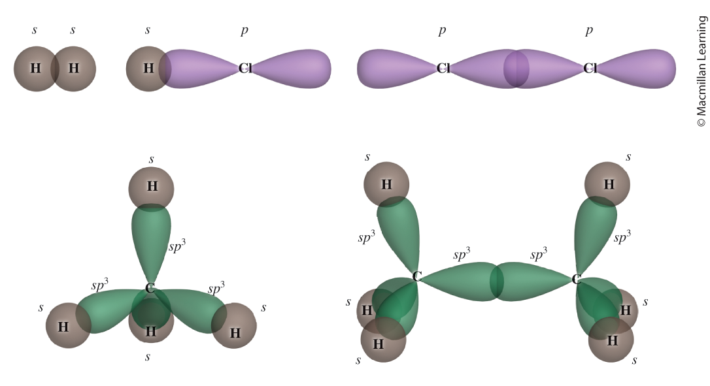
Valence bond (VB) theory: sigma bond
Single bonds consists of one sigma (σ) bond

Slide 13
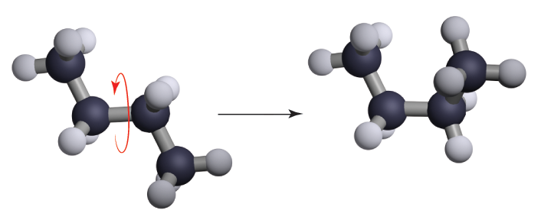
Valence bond (VB) theory: sigma bond
Single bond is able to freely rotate about the bond

Slide 14
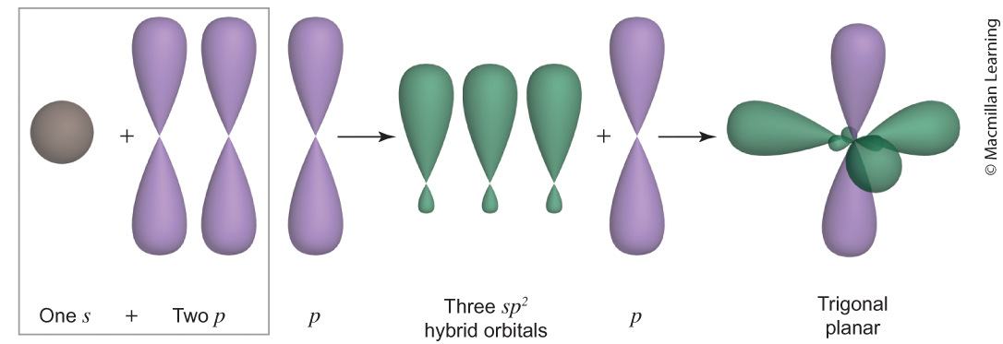

Valence bond (VB) theory: sp² orbitals
Mixing of 1 s and 2 p orbitals to form 3 sp² hybrid orbitals
Double bond contains 1 sigma (σ) bond and 1 pi (π) bond (overlap of 2 p orbitals)

Slide 15
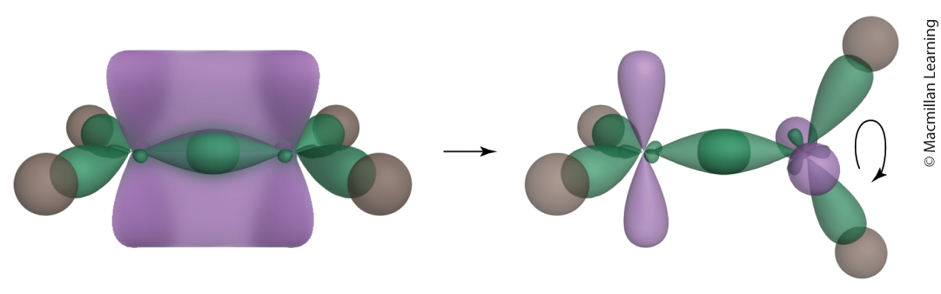
Valence bond (VB) theory: sp² orbitals
Mixing of 1 s and 2 p orbitals to form 3 sp² hybrid orbitals
Double bond contains 1 sigma (σ) bond and 1 pi (π) bond (overlap of 2 p orbitals)

Slide 16
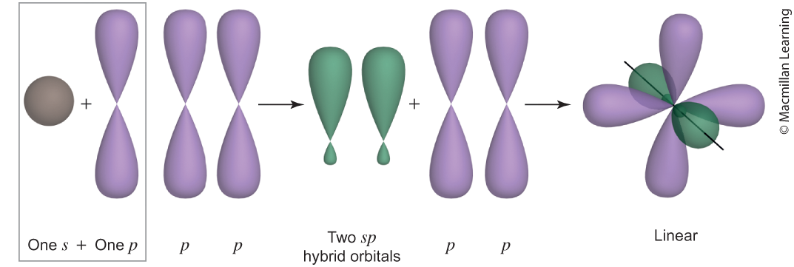
Valence bond (VB) theory: sp orbitals
Mixing of 1 s and 1 p orbitals to form 2 sp hybrid orbitals
Triple bond contains 1 sigma (σ) bond and 2 pi (π) bonds (overalp of 2 sets of 2 p orbitals)

Slide 17
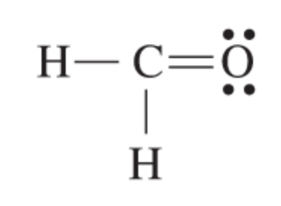
Example: formaldehyde
Determine the molecular geometry, hybridization at the central atom, and number of sigma/pi bonds for formaldehyde

Slide 18

Example: hydrogen cyanide
Determine the molecular geometry, hybridization at the central atom, and number of sigma/pi bonds for formaldehyde

Slide 19
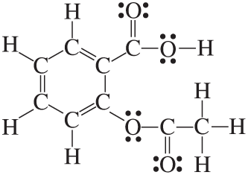
Your Example: salicylic acid (aspirin)
Determine the molecular geometry, hybridization at each central atom, and total number of sigma/pi bonds for formaldehyde

Slide 20
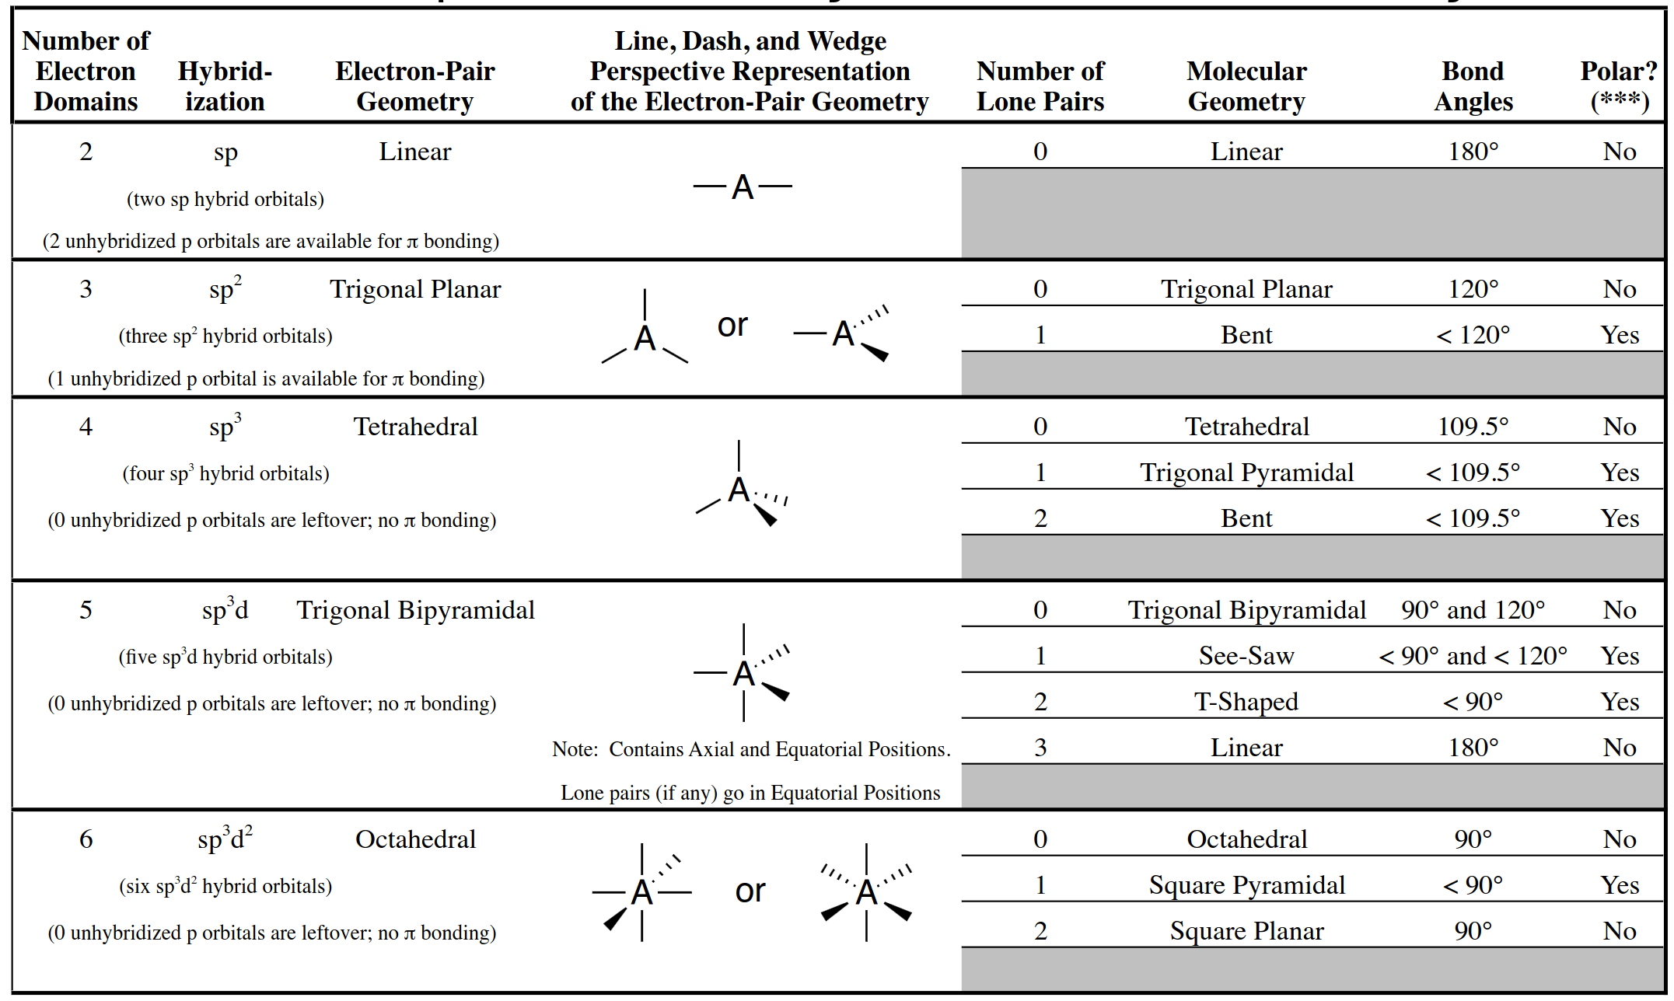
Table of hybridized orbitals and molecular geometries

Slide 21
Outline
Announcements
Ch. 11: Molecular Shape and Bonding Theories
Valence Bond Theory – Hybrid Orbitals
Molecular Orbital Theory – Molecular Orbitals
Ch. 12: Liquids and Solids
Intermolecular Forces – Connection to Real World
Phase Changes and Heating Curves
Vapor Pressure, Viscosity, Freezing/Boiling Point, and Surface Tension
Phase Diagrams
Types of Solids

Slide 22
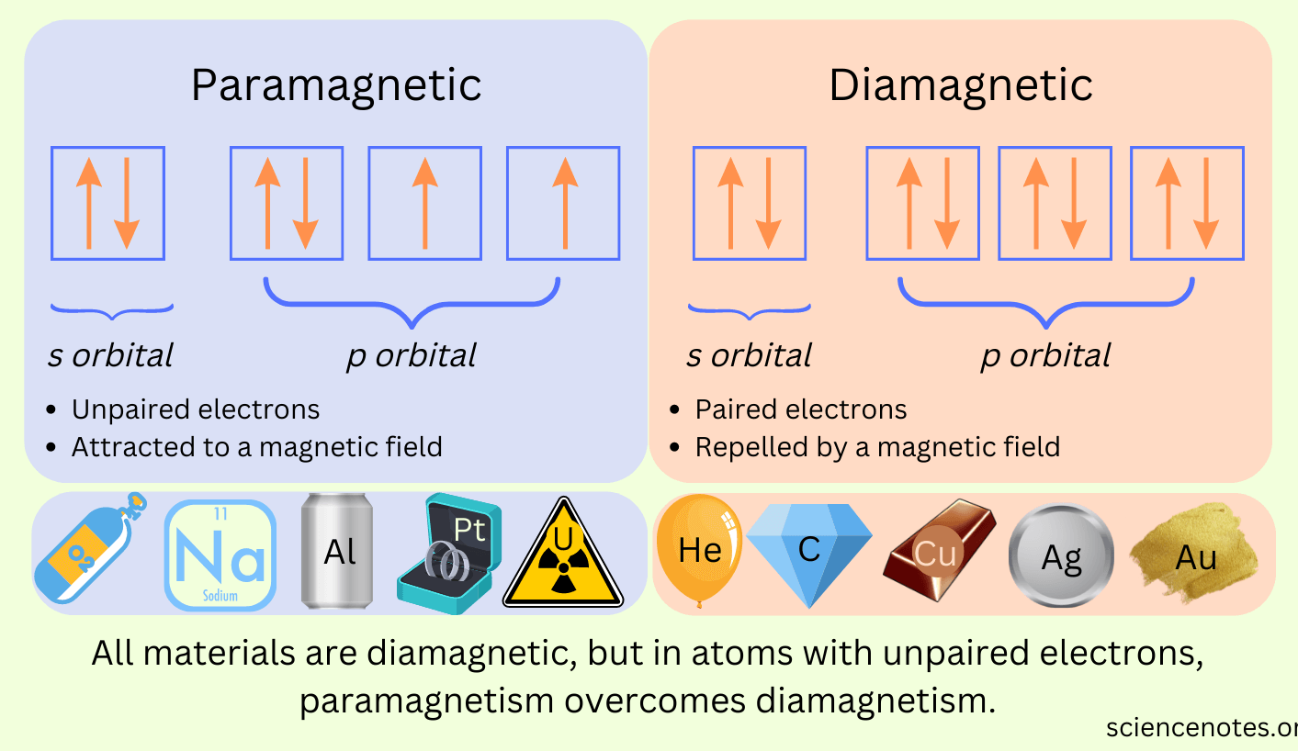
Molecular orbital theory
Limitation of Valence Band Theory – unable to explain electronic energy within the molecule and magnetic properties such as paramagnetism (unpaired electrons) and diamagnetism (paired electrons)

Slide 23
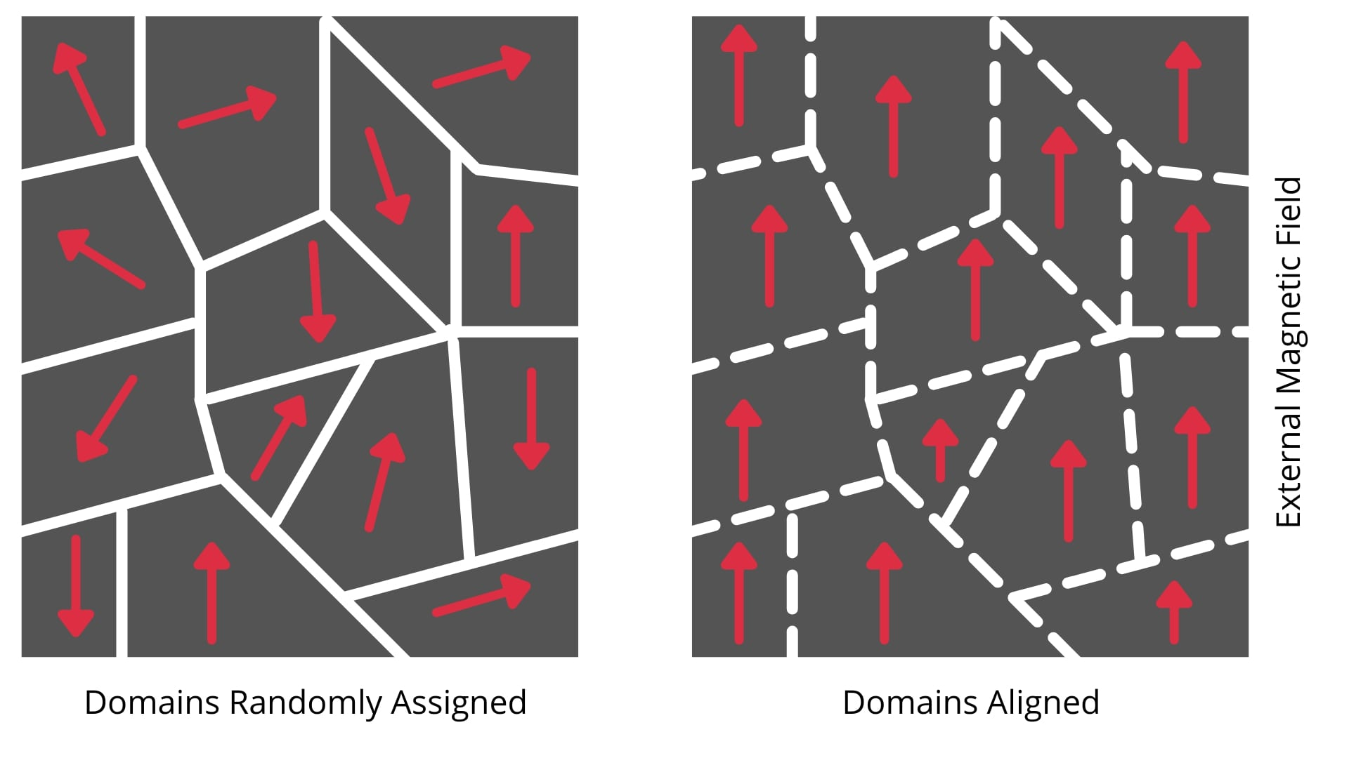
Paramagnetism (short-lived) vs ferromagnetism (Retain magneticism)

Slide 24
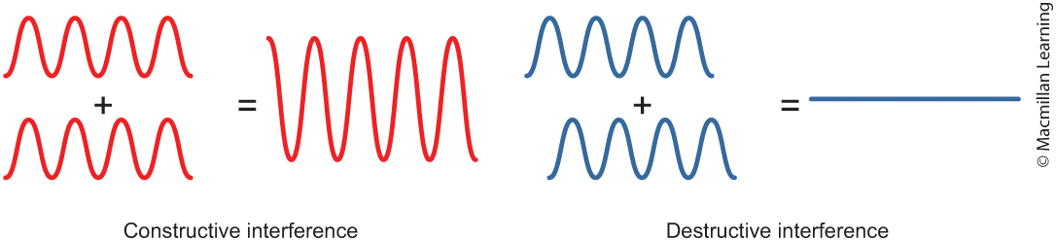
Molecular orbital theory
Atomic orbitals of different atoms combine to form molecular orbitals that delocalized over the resulting molecule
Atomic orbitals can combine constructively or destructively
Q: How is this different from the Valence Bond Theory?

Slide 25
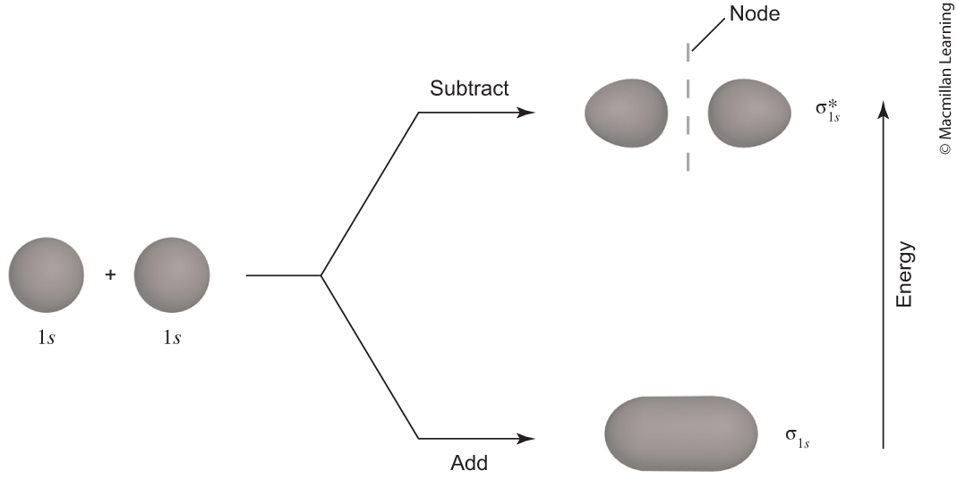
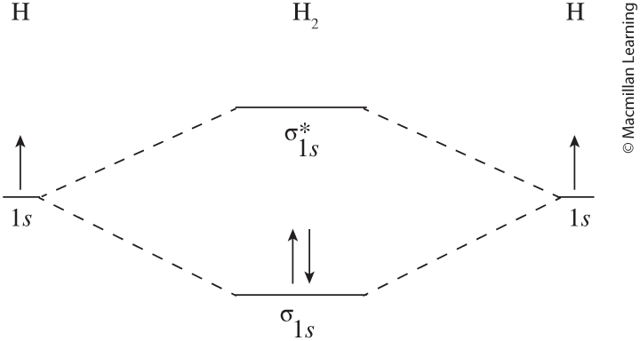
Molecular orbital theory
Combination of atomic orbitals form bonding orbitals (σ/π) and antibonding orbitals (σ*/π*) e.g. H₂ molecule

Slide 26
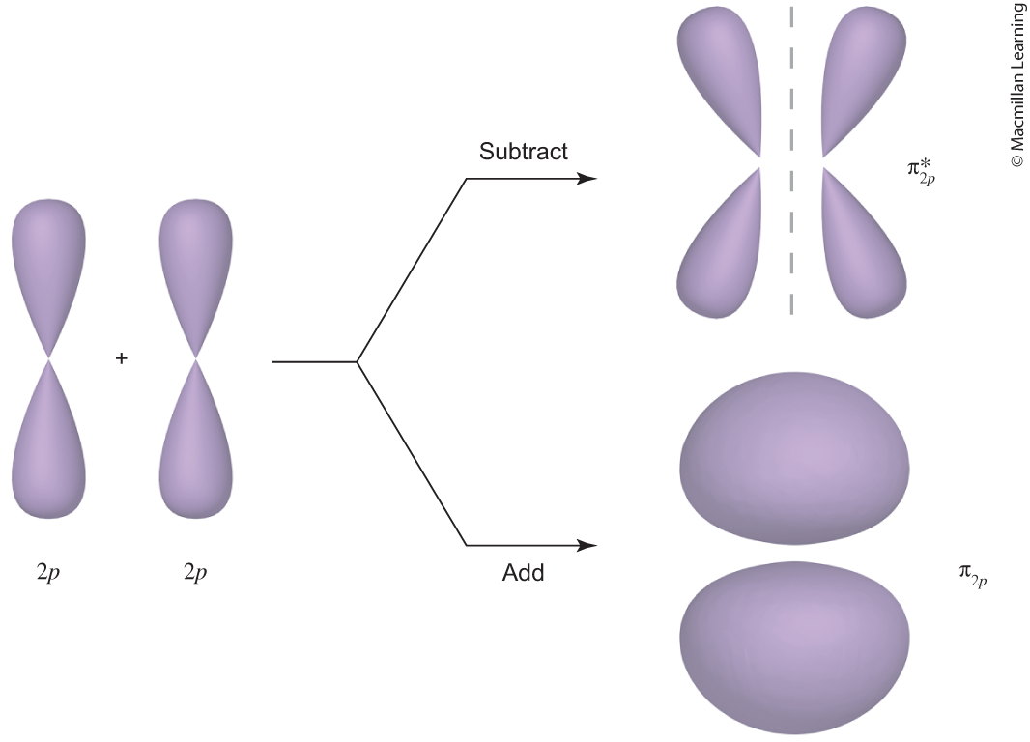
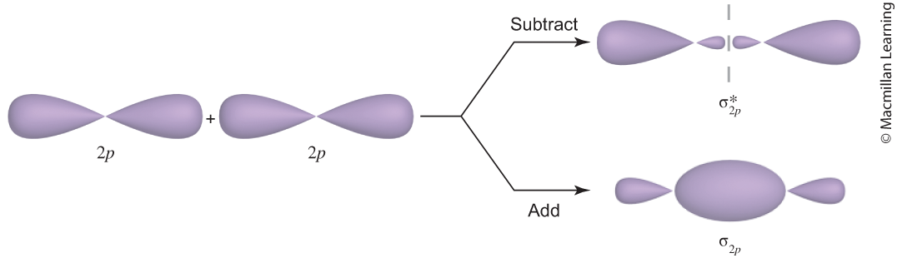
Molecular orbital theory
Combination of atomic orbitals form bonding orbitals (σ/π) and antibonding orbitals (σ*/π*) e.g. p orbitals

Slide 27
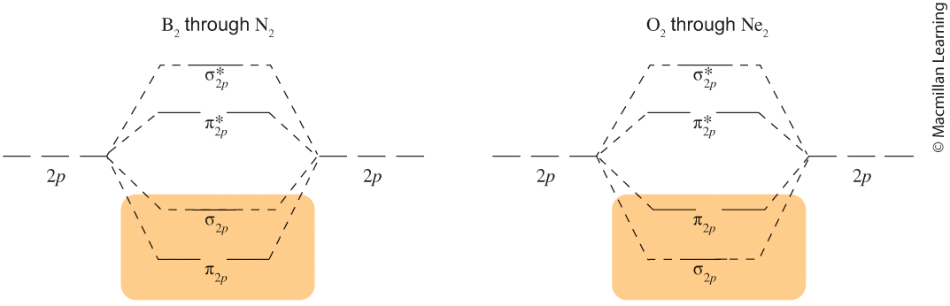
Molecular orbital theory
Combination of atomic orbitals form bonding orbitals (σ/π) and antibonding orbitals (σ*/π*) e.g. p orbitals

Slide 28
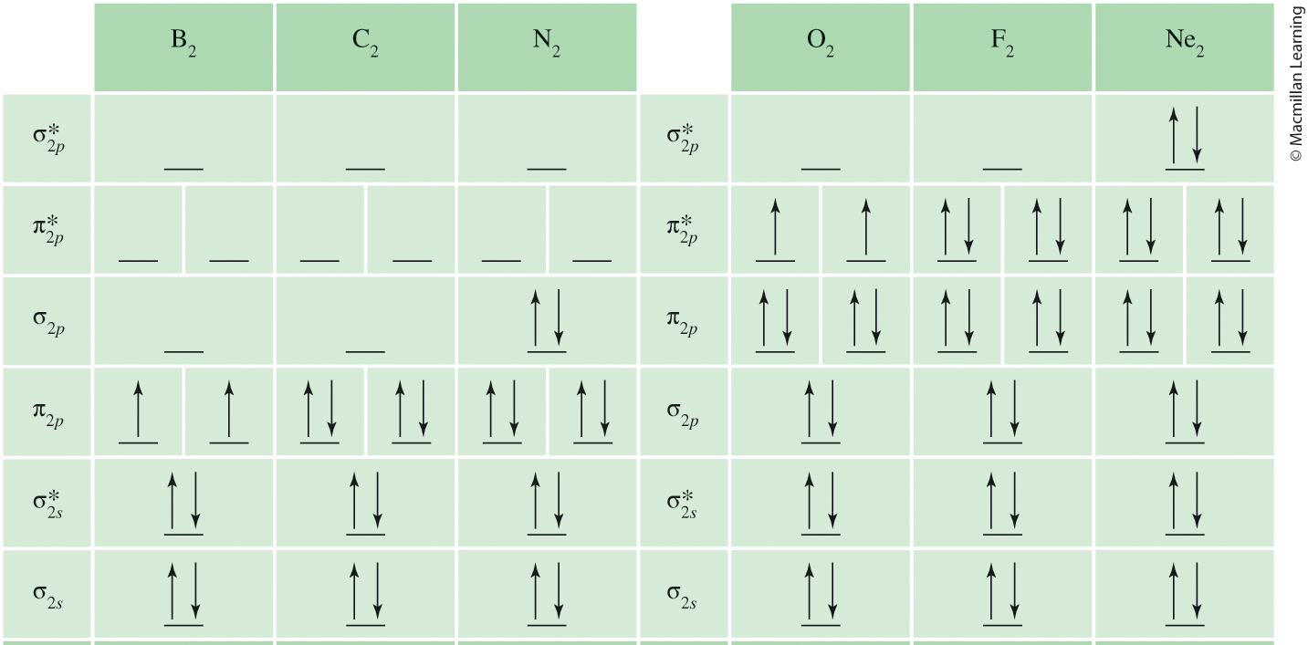
Molecular orbital theory
Filling molecular orbitals follow Hund's Rule

Slide 29
Outline
Announcements
Ch. 11: Molecular Shape and Bonding Theories
Valence Bond Theory – Hybrid Orbitals
Molecular Orbital Theory – Molecular Orbitals
Ch. 12: Liquids and Solids
Intermolecular Forces – Connection to Real World
Phase Changes and Heating Curves
Vapor Pressure, Viscosity, Freezing/Boiling Point, and Surface Tension
Phase Diagrams
Types of Solids

Slide 30
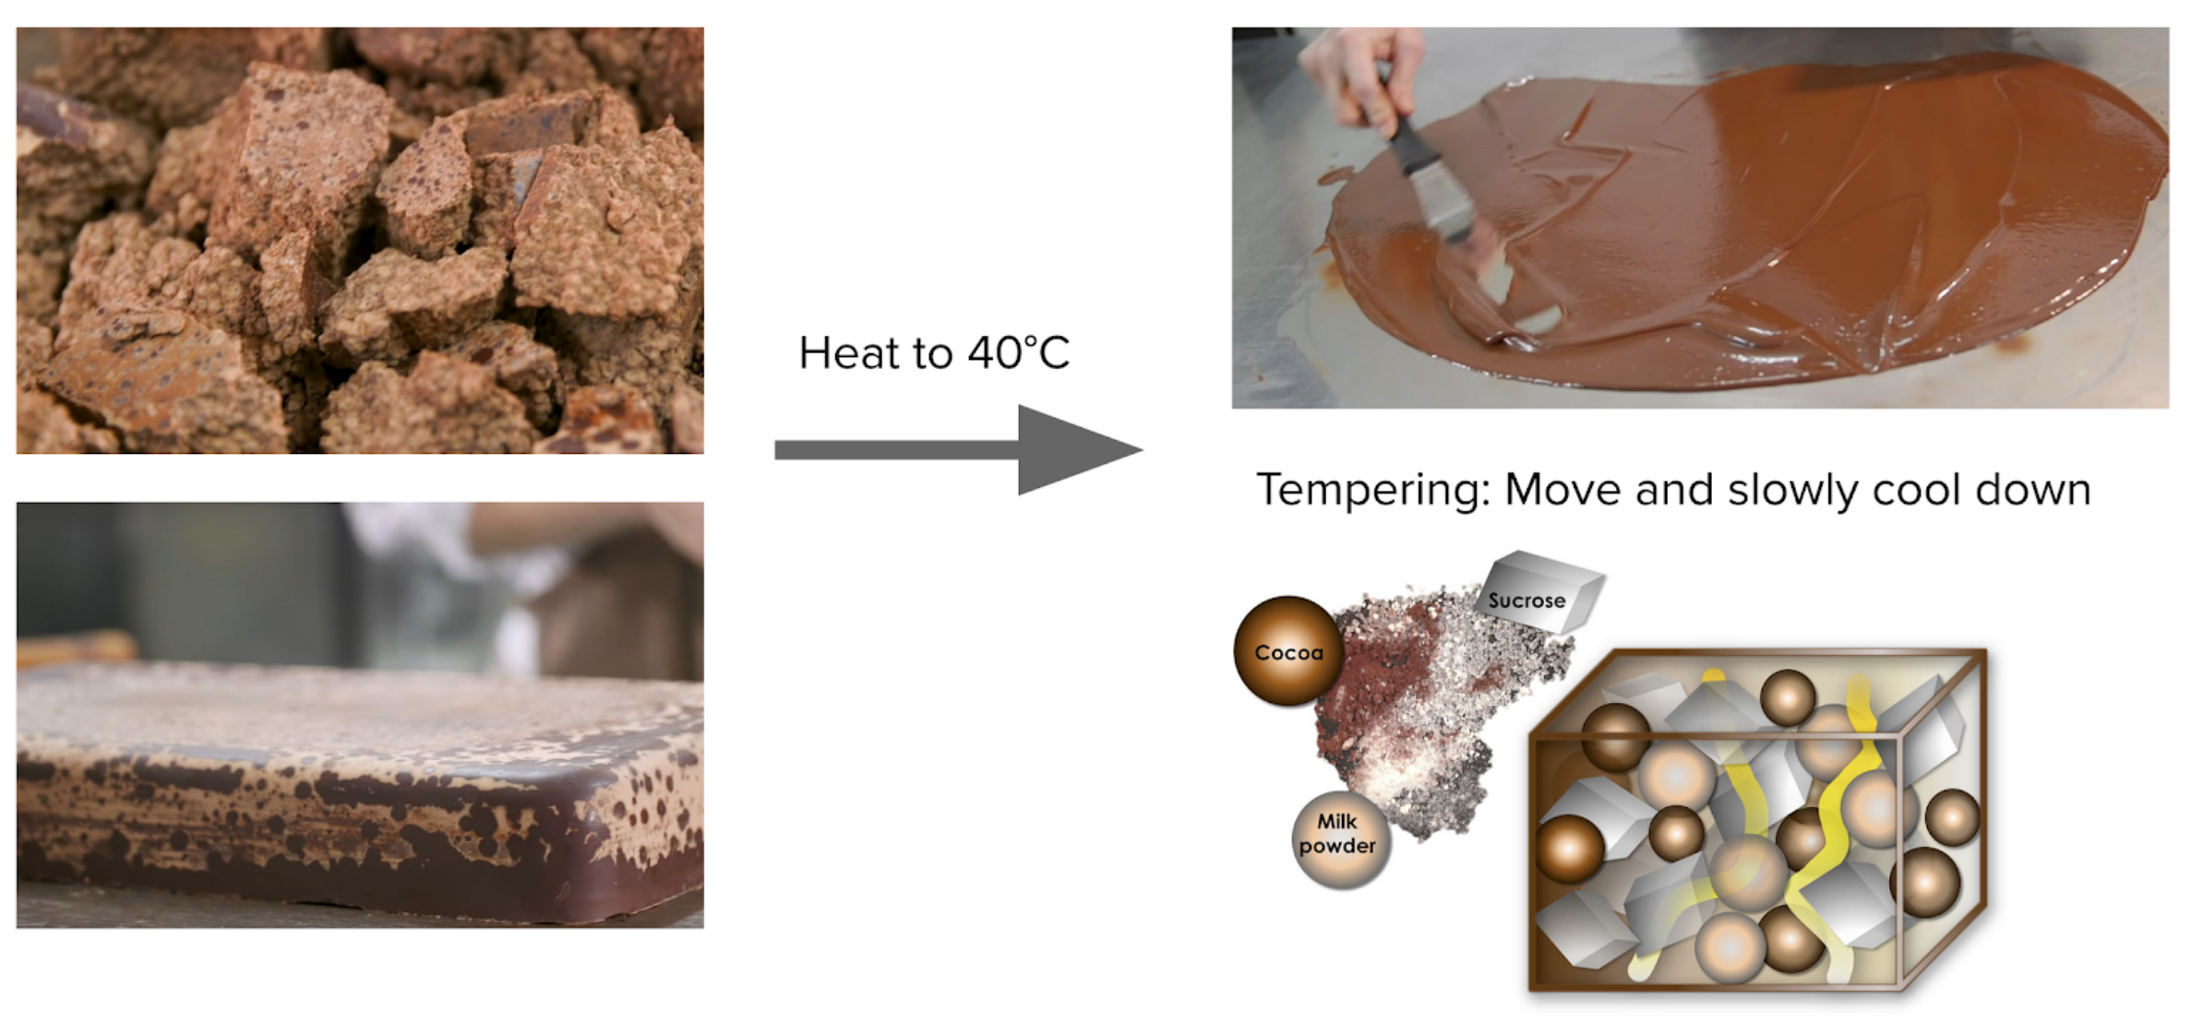
Real world connection: intermolecular forces
Chocolate Making Process

Slide 31
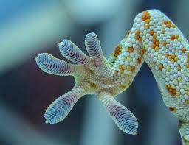
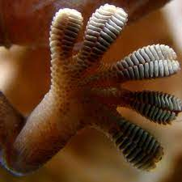
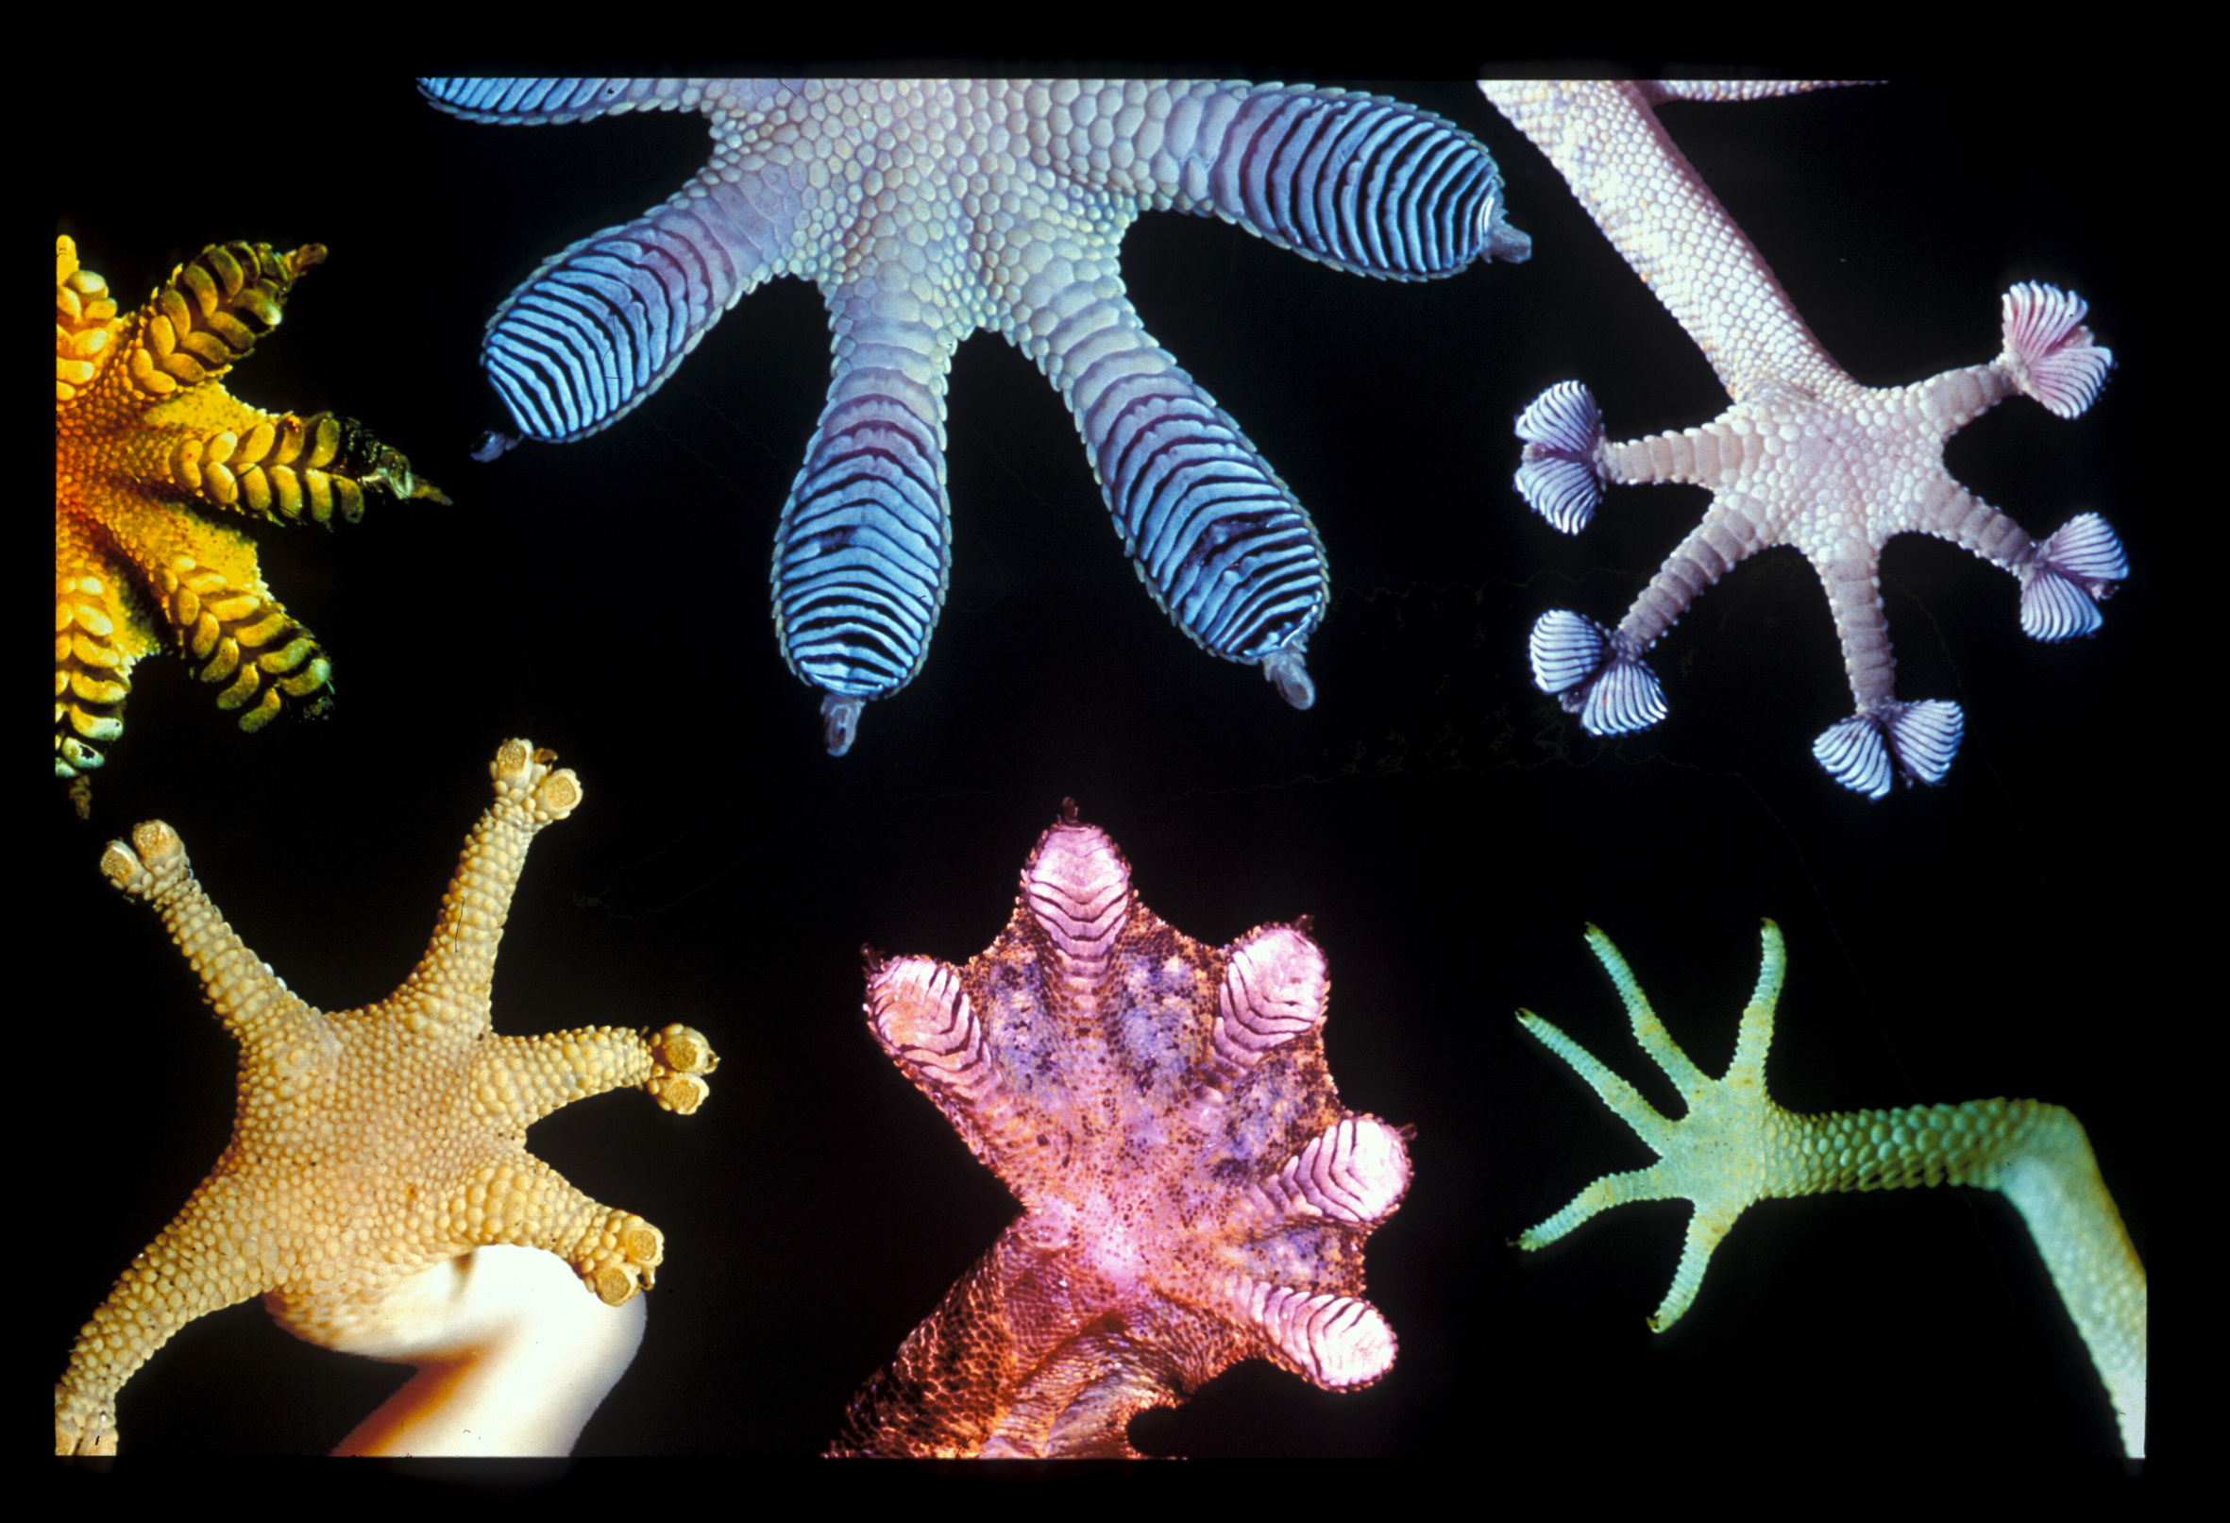
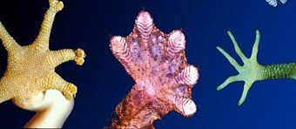
Real world connection: intermolecular forces
Gecko's Feet

Slide 32
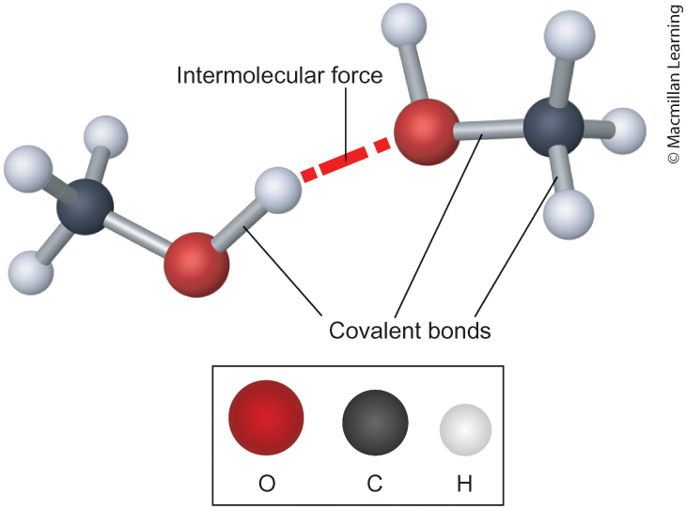
Intermolecular forces
Intramolecular interactions – interactions within the molecule
Intermolecular interactions – Interactions between molecules
Play an important role determine relative freezing/boiling points, viscosity, vapor pressure, and surface tension

Slide 33
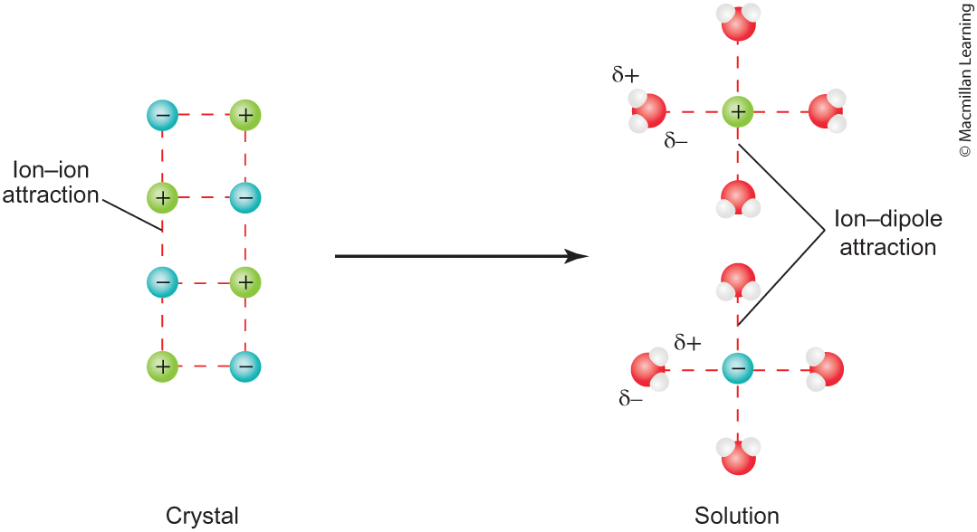
Types of Intermolecular forces: Ion-Dipole (strongest)

Slide 34
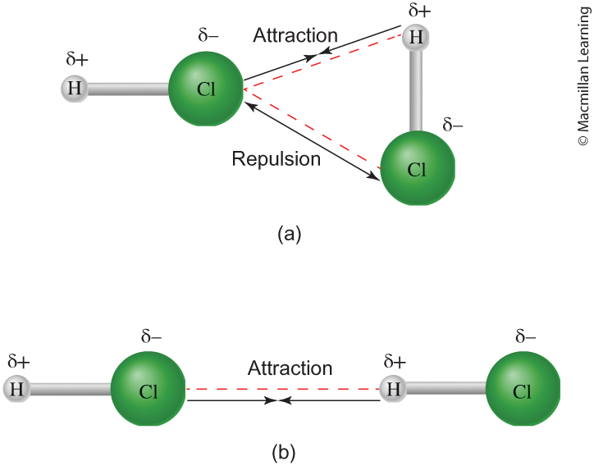
Types of Intermolecular forces: Dipole-Dipole

Slide 35
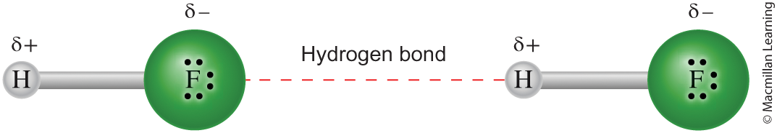
Type of intermolecular forces: Hydrogen bonding
A stronger type of dipole-dipole interaction, only applicable when H atom is attached to N, O, and F (due to high electronegativity)
Hydrofluoric acid (HF) has one hydrogen donor and 3 lone pairs to accept the hydrogen

Slide 36
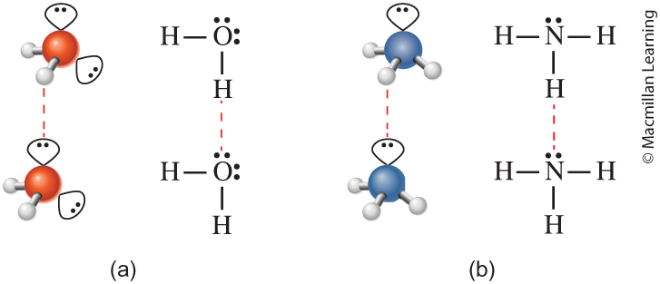
Type of intermolecular forces: Hydrogen bonding
A stronger type of dipole-dipole interaction, only applicable when H atom is attached to N, O, and F (due to high electronegativity)
Water (H₂O) has 2hydrogen donors and 2 lone pairs
Ammonia (NH₃) has 3 hydrogen donors but only 1 lone pairs

Slide 37

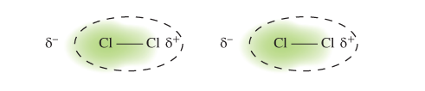
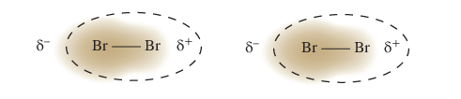
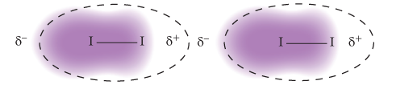
Type of intermolecular forces: Dispersion (weakest)
Universal and present in all molecules
Textbook definition – instantaneous dipole moments
Strength of dispersion grows with the size of the molecule

Slide 38
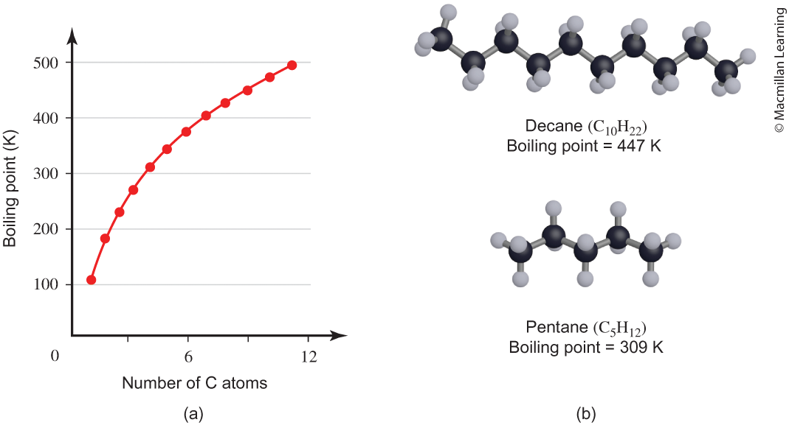
Intermolecular forces and boiling point
Stronger intermolecular forces lead to higher boiling point
Q: Identify the intermolecular forces for decane and pentane.

Slide 39
Example: water and ammonia boiling points
Which one has the higher boiling point? Hint: Identify all intermolecular forces.

